Slide 1

College Enrollment
Academic Year 2019 -2020

Slide 2

College Wide Enrollment

Slide 3
Students Enrolled
How many students were enrolled during the academic year?
Total_2019/20 | Fall_2019 | Spring_2020 | Summer_2020
101608 | 75290 | 68401 | 35964
 |  | -9.15% | -47.42%
Avg credits per student

Slide 4
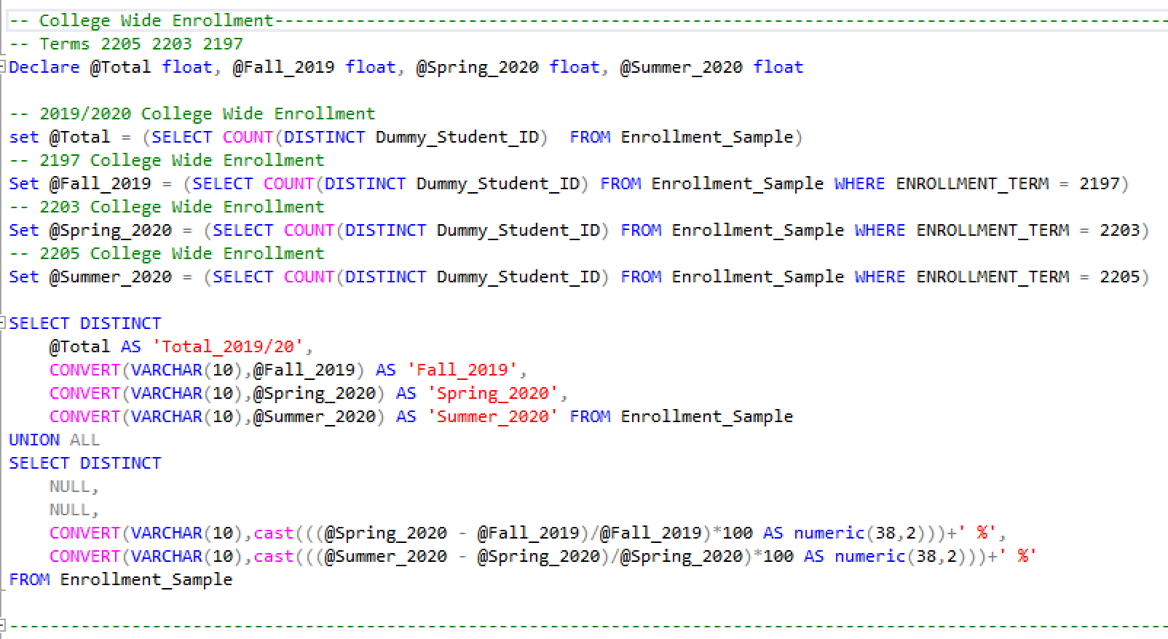

MiamiDadeCollege

Slide 5
Enrolled Credits
Credits Enrolled
How many credits were students enroll for during the academic during the academic year?

Slide 6
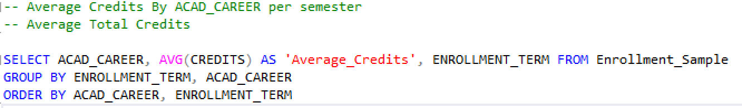
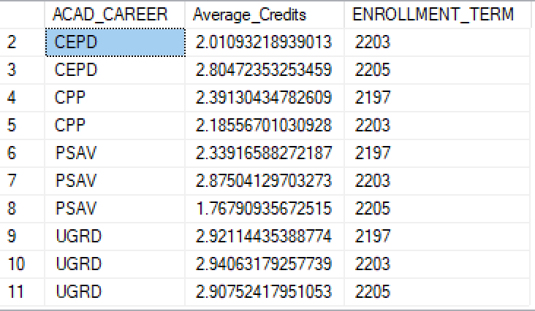
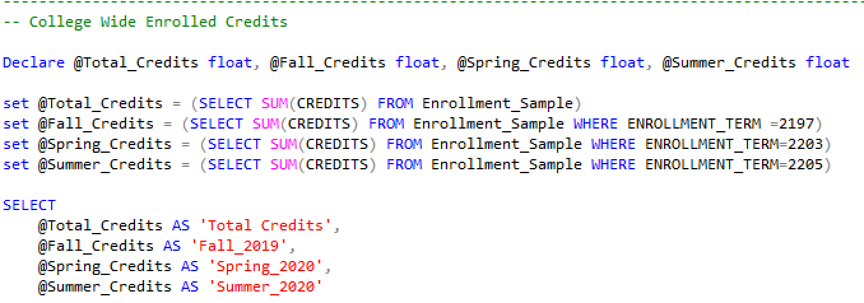

Slide 7
Student Demographics
What does our student body look like?

Slide 8
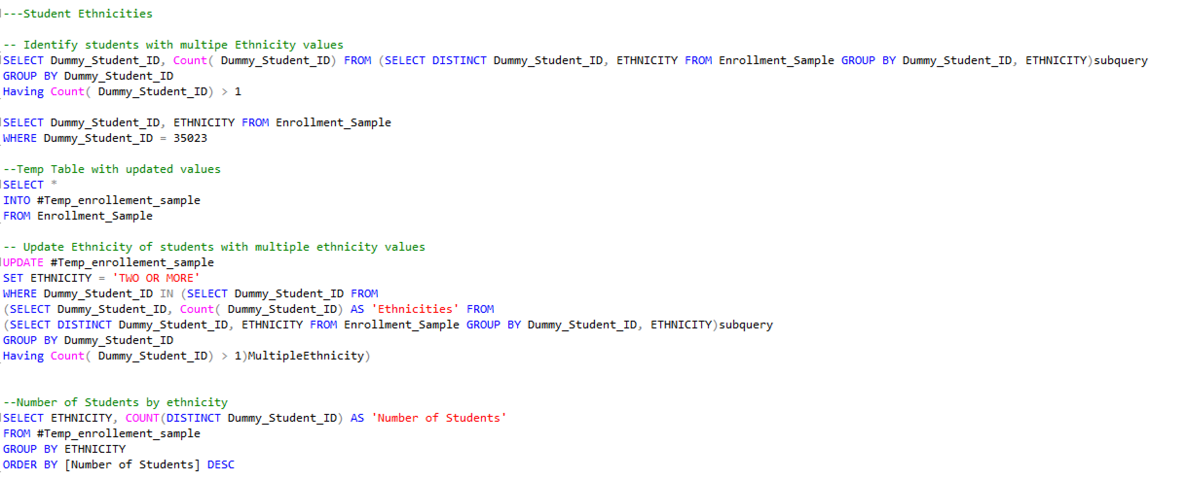

Slide 9
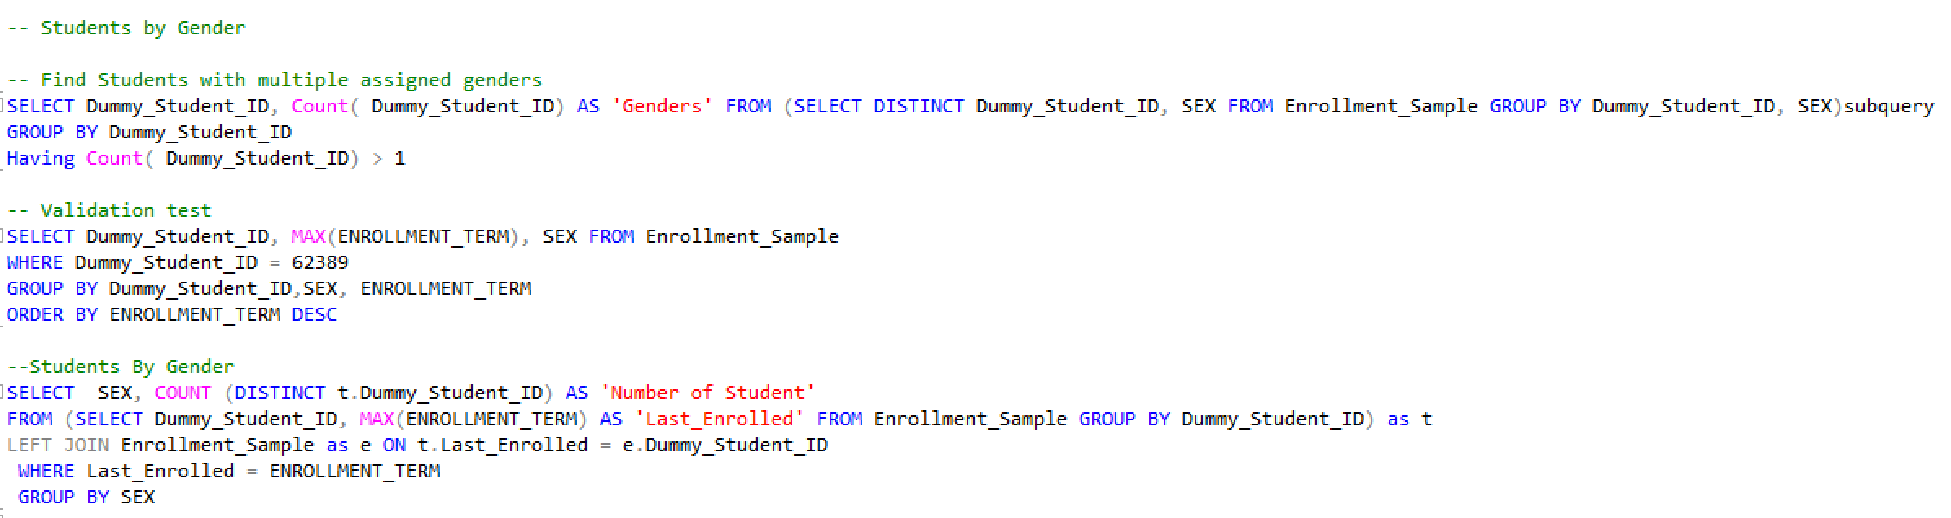
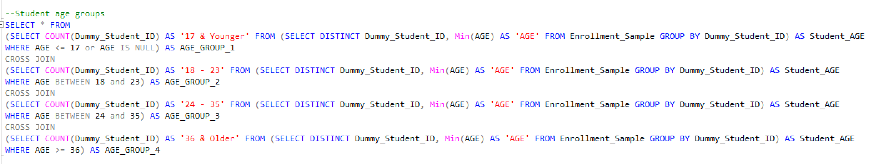

Slide 10

Enrollment by Campus

Slide 13
Campus Enrollments by Semester
Fall 2019
Location/Campus | Students Head Count | Total Credits | Average Credits
COLLEGE WIDE | 75290 | 607008.2 | 8.1
VIRTU | 11394 | 59834.0 | 5.3
WOLF | 14538 | 99342.8 | 6.8
HIA | 6821 | 46828.4 | 6.9
WEST | 5481 | 37251.0 | 6.8
KENDL | 21037 | 157625.6 | 7.5
MEEK | 1000 | 4094.0 | 4.1
HOME | 5650 | 36718.0 | 6.5
NORTH | 14812 | 100701.5 | 6.8
IAC | 7005 | 43685.7 | 6.2
MEDI | 2987 | 20927.1 | 7.0
Spring 2020
Location/Campus | Students Head Count | Total Credits | Average Credits
COLLEGE WIDE | 68401 | 556325.9 | 8.1
VIRTU | 11639 | 61766.0 | 5.3
WOLF | 13699 | 95192.1 | 6.9
HIA | 6329 | 40516.3 | 6.4
WEST | 5276 | 33590.2 | 6.4
KENDL | 18294 | 134078.4 | 7.3
MEEK | 956 | 3947.0 | 4.1
HOME | 5213 | 33263.2 | 6.4
NORTH | 13617 | 92613.6 | 6.8
IAC | 6420 | 38804.2 | 6.0
MEDI | 3132 | 22555.0 | 7.2
Summer 2020
Location/Campus | Students Head Count | Total Credits | Average Credits
COLLEGE WIDE | 35964 | 261772.7 | 7.3
VIRTU | 9551 | 49019.5 | 5.1
WOLF | 6905 | 35207.2 | 5.1
HIA | 3889 | 19492.6 | 5.0
WEST | 2751 | 12713.2 | 4.6
KENDL | 9882 | 51234.8 | 5.2
MEEK | 1186 | 4439.0 | 3.7
HOME | 3079 | 14786.5 | 4.8
NORTH | 7518 | 38790.5 | 5.2
IAC | 4555 | 21681.3 | 4.8
MEDI | 2335 | 14408.2 | 6.2

Slide 14
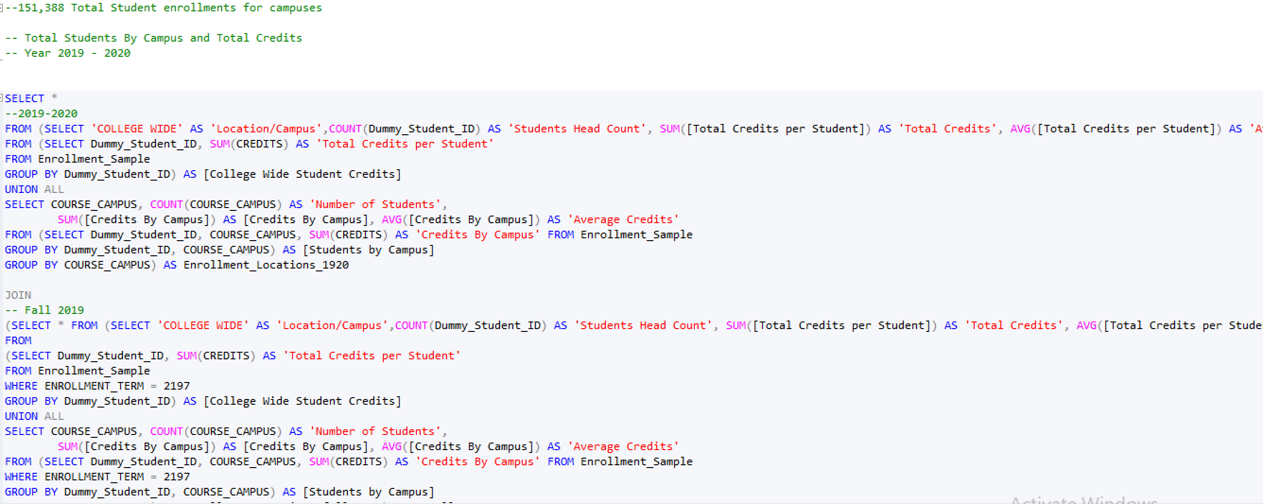

Slide 15

Course Offerings

Slide 16

Most Registered Courses

Slide 17
ENC1101

Slide 18
